Slide 1

Lending Club Case Study
By: Rutuja Jadhav

Slide 2
Roadmap
Importing Required Libraries
Loading Dataset
Cleaning Data and Understanding Data
Univariate Analysis
Bivariate Analysis
Insights

Slide 3
1. Importing Required Libraries
NumPy
Pandas
Matplotlib
Seaborn

Slide 4
2. Loading Dataset
Loaded ‘loan.csv’ dataset
Understanding the ‘data-dictionary.csv’ (column definition) dataset

Slide 5
3. Cleaning Data and Understanding Data
Removing columns with large Null values
Removing columns irrelevant to the study
Fixing Null values
Correcting data types and deriving new columns
Identifying outliers
Removing outliers

Slide 6
4. Univariate Analysis

Slide 7
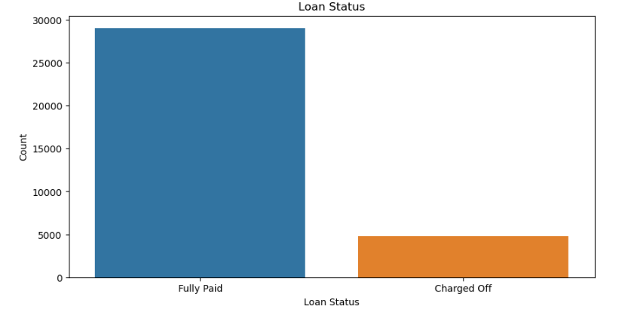
a. Loan Status
The percentage of Charged Off (14.22%) is less than Fully Paid (85.77%) of the total count
Majority of the people have paid off their loans. We can target such people and provide them loans in future to avoid business loss.

Slide 8
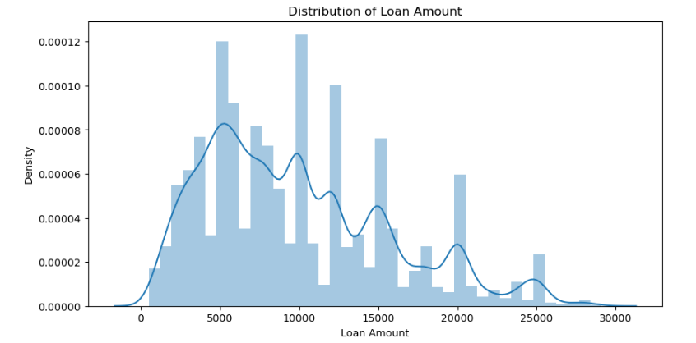
c. Loan Amount
Loan amount ranges between 500 to 35000.
Most of the people borrowed loan for less than 15000
Most of the people opted for loans with rounded values like 5000, 10000, 12000, 15000.

Slide 9
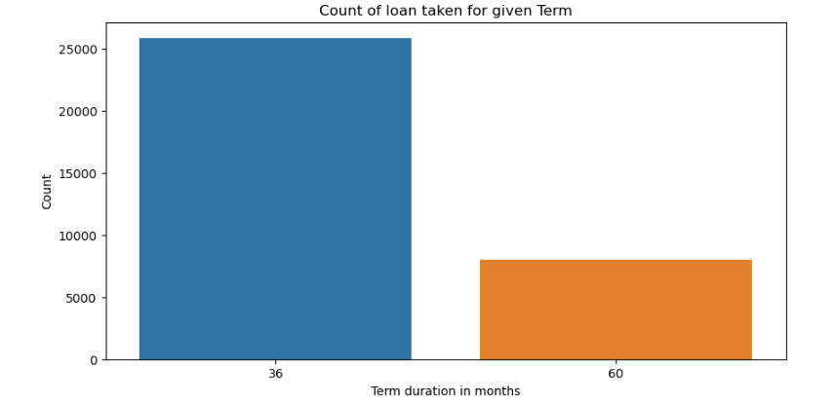
b. Loan Term
There are two values for Tenure Period: 36 months and 60 months
Majority of the people have opted for 36 months Tenure Period.

Slide 10
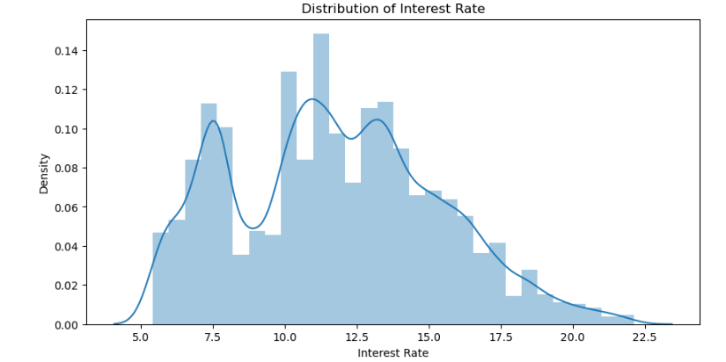
d. Interest Rate
The distribution of Interest Rate is high around 7.5% and between 10%-15% bracket.
The Interest Rate has a drastic low between 7.5%-10% bracket and again increasing after 10%.

Slide 11
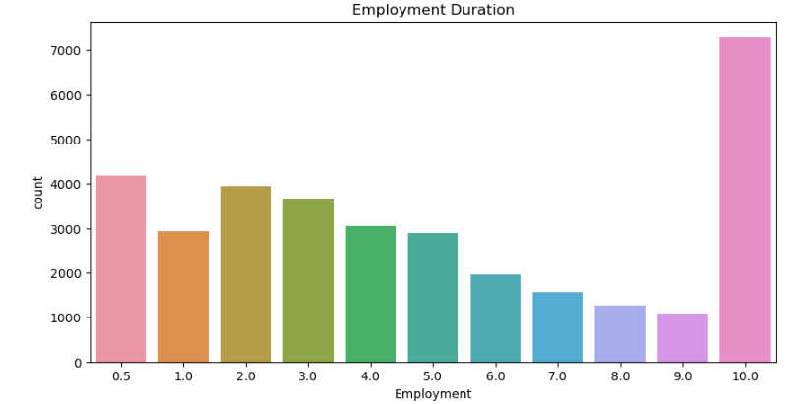
e. Employment Duration
People having 10+ years of work experience are the majority of the loan applicants.
The count is also high for those who have less than an years work experience.

Slide 12
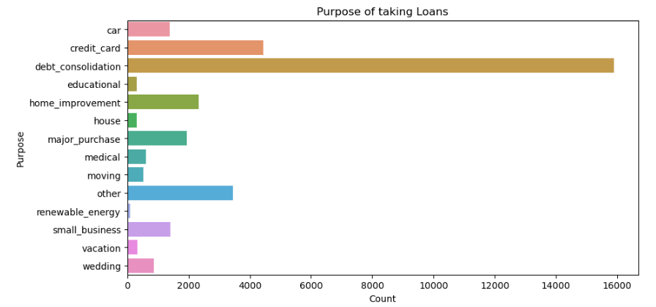
f. Purpose
The purpose of taking loan is Debt Consolidation followed by Credit Card and Other.

Slide 13
5. Bivariate Analysis

Slide 14
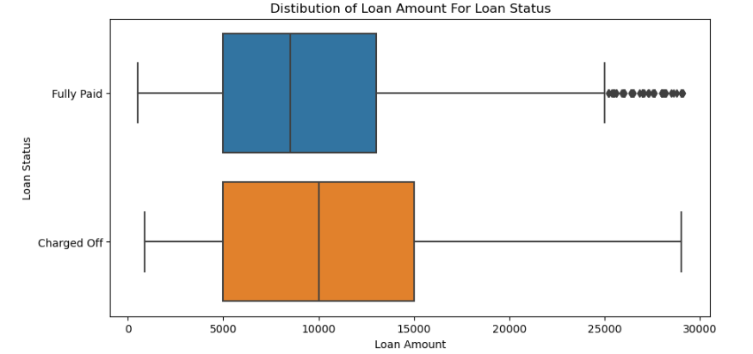
a. Loan Amount VS Loan Status
Majority of the loan applicants have taken loan for small loan amount
Higher loan amount leads to high risk of being Charged Off.

Slide 15
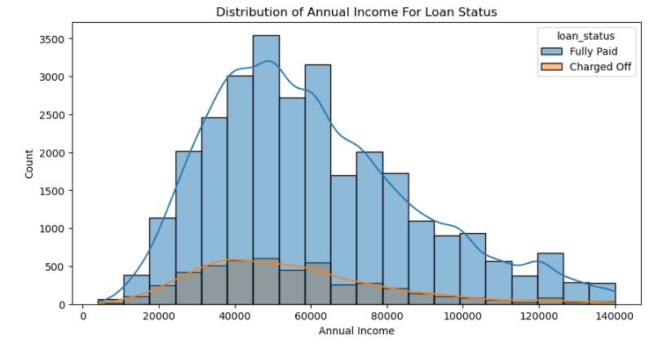
a. Annual Income VS Loan Status
Majority of the loan applicants have low income between 20000 to 60000.
Loan applicants with income less than 50000 are likely to be charged off.

Slide 16
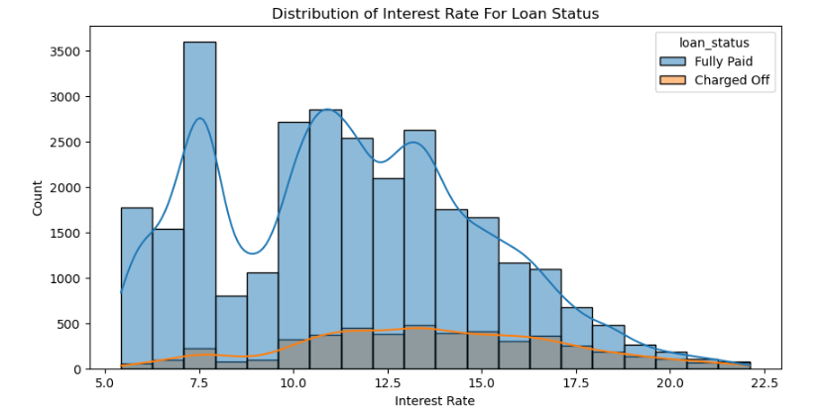
b. Interest Rate VS Loan Status
The chances of defaulting increase with the increase in the Interest Rate.

Slide 17
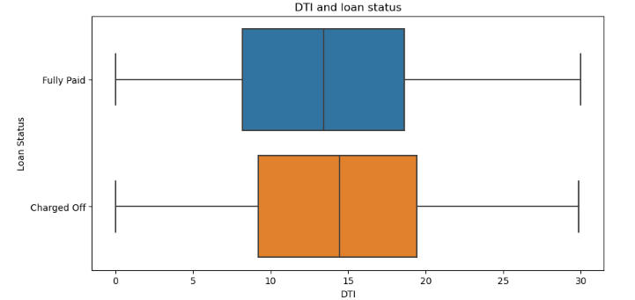
c. DTI VS Loan Status
Majority of the loan applicants have a large DTI (Debt to Income) ratio.
Lending loans to such applicants can lead to Business loss.

Slide 18
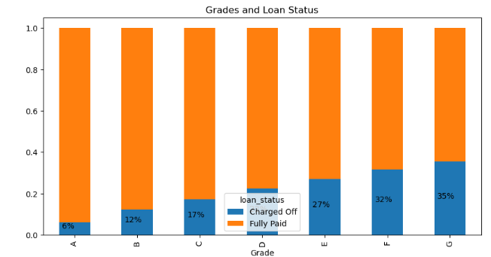
g. Grades VS Loan Status
As the Grade gets lower (A to G) the Charged Off rate also increases proportionally.

Slide 19
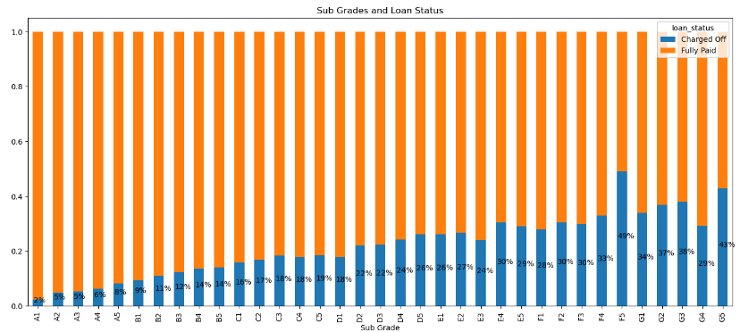
h. Sub Grades VS Loan Status
Similar to Grades, as the Sub Grade gets lower (A1 to G5) the Charged Off rate also increases proportionally.
Giving loans to lower grades, preferably A1 is more beneficial.

Slide 20
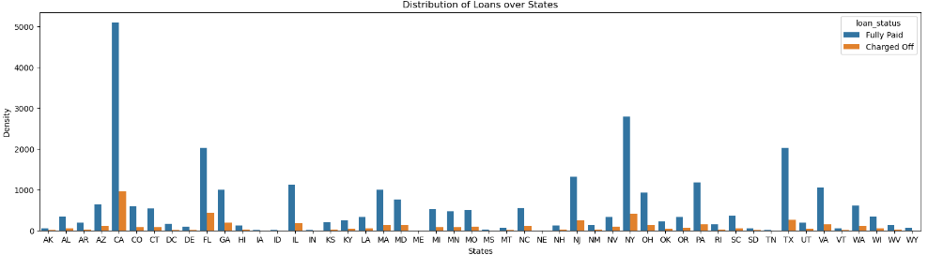
i. Location
Majority of the loan applicants are based off of metropolitan cities.
Metropolitan cities also have a comparatively higher amount of Charged Off applicants but the chances of defaulting are also low.

Slide 21
Thank You!

